Slide 1
Language Translator
Parmar Jaimin S.
Roll No :- IT065
Id:- 17ITUBF013
Parmar Darshik B.
Roll No :- IT063
Id:- 17ITUSF129
Parmar Darshita R.
Roll No :- IT064
Id:- 17ITUBS073

Slide 2
Fetures of Binary to Decimal code
The Binary Numbering System is the most fundamental numbering system in all digital and computer based systems and binary numbers follow the same set of rules as the decimal numbering system. But unlike the decimal system which uses powers of ten, the binary numbering system works on powers of two giving a binary to decimal conversion from base-2 to base-10.
Digital logic and computer systems use just two values or states to represent a condition, a logic level “1” or a logic level “0”, and each “0” and “1” is considered to be a single digit in a Base-of-2 (bi) or “binary numbering system”.
In the binary numbering system, a binary number such as 101100101 is expressed with a string of “1’s” and “0’s” with each digit along the string from right to left having a value twice that of the previous digit. But as it is a binary digit it can only have a value of either “1” or “0” therefore, q is equal to “2” (0 or 1) with its position indicating its weight within the string.

Slide 3
Binary to Decimal .L file code
%{
/* Definition section */
#include<stdio.h>
#include<stdlib.h>
#include"y.tab.h"
int yyerror(char *);
extern int yylval;
%}
/* Rule Section */
%%
[0] {yylval=0;return ZERODIGIT;}
[1] {yylval=1;return ONEDIGIT;}
[ \t] {;}
\n return 0;
. yyerror("Invalid Character");
%%
int yywrap(void) { return 1; }

Slide 4
Binary to Decimal .Y file code
%{ /* Definition section */
#include<stdio.h>
#include<stdlib.h>
int yylex(void);
int yyerror(char *);
%}
%token ZERODIGIT ONEDIGIT
/* Rule Section */
%%
N: L {printf("%d\n", $$);}
L: L B {$$=$1*2+$2;}
| B {$$=$1;}
B:ZERODIGIT {$$=$1;}
|ONEDIGIT {$$=$1;};
%%

Slide 5
Binary to Decimal .Y file code
int main()
{
printf("Conversion of Binary to Decimal:\n");
while(1){ yyparse(); }
return 0;
}
int yyerror(char *s) { printf("%s\n",s); }

Slide 6
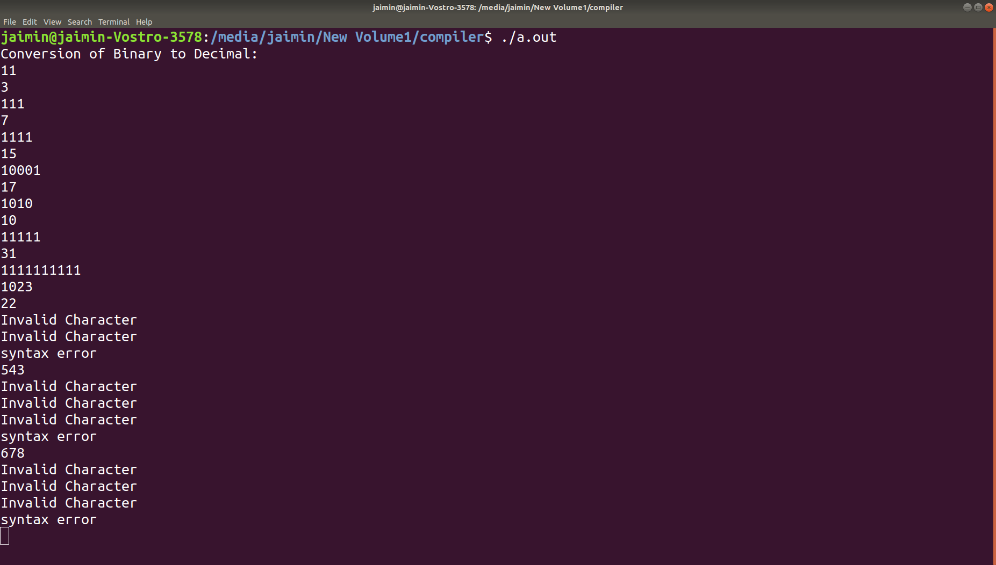
Output1

Slide 7
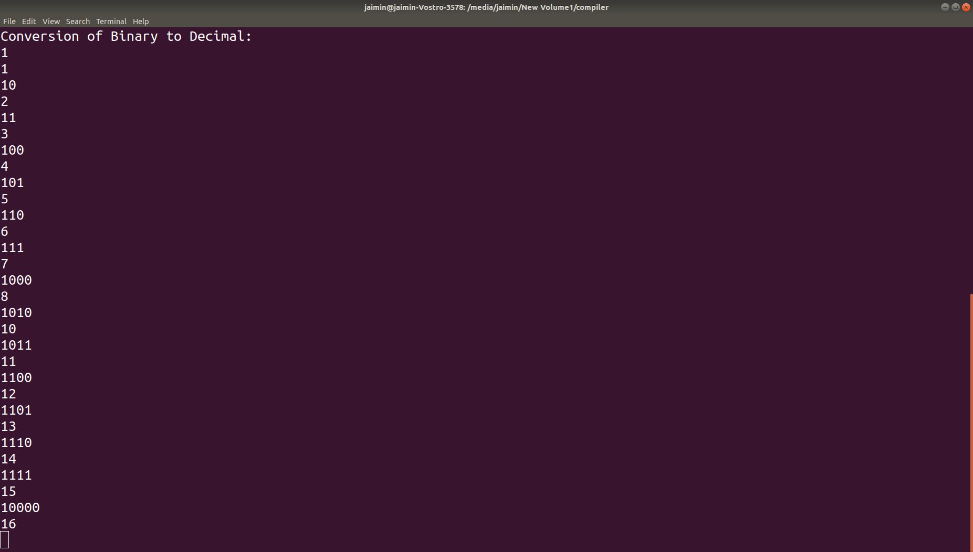
Output2

